Slide 1
WP6 Overview

Slide 2
ModelWriter Architecture
Authoring tool - The Editor → the only tool that users will actually interact with
authentication → to provide rights (w|r etc.)
Notification → After an Edition
Compiler → to generate the models basing on model’s links in the Document
Synchronizer → synchronize the informations described in the Document with the user's development artifacts and environment
Documentation Generator → Automatical generation of a documentation (textile, HTML, Latex, PDF...) from the Document

Slide 3
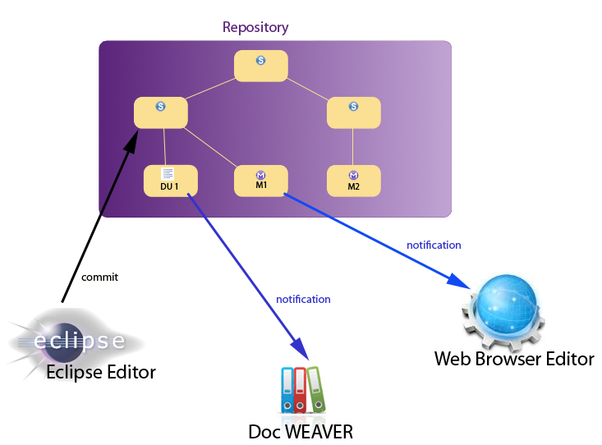

Slide 4
Major contributors per envisioned tasks
T6.1 - Experimental Prototyping (Obeo + SA + VUB)
T6.2 - Architectural Design (Obeo + SA + VUB + Mantis + UNIT + technological WP Leaders)
T6.3 - Writer Part enhancements (SA)
T6.4 User Interfaces Implementation (SA + Obeo)
T6.5 - Acceptance Test Plan (SA + UNIT + KS + ALL)
T6.6 - Acceptance Test Procedures (SA + UNIT + KS + ALL)
T6.7 - ModelWriter Integration (Obeo + UNIT + ALL)
T6.8 - Cyclic Evaluation of Analysis Performance (SA + Obeo + LORIA + UNIT + KS + ALL)

Slide 5
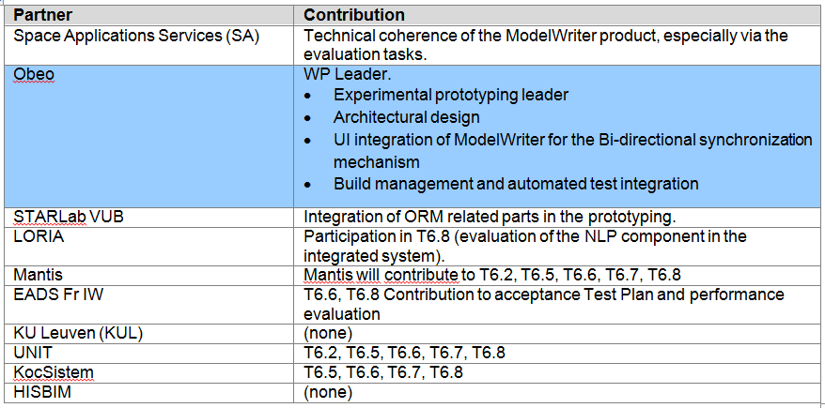
WP6 Contributions

Slide 6
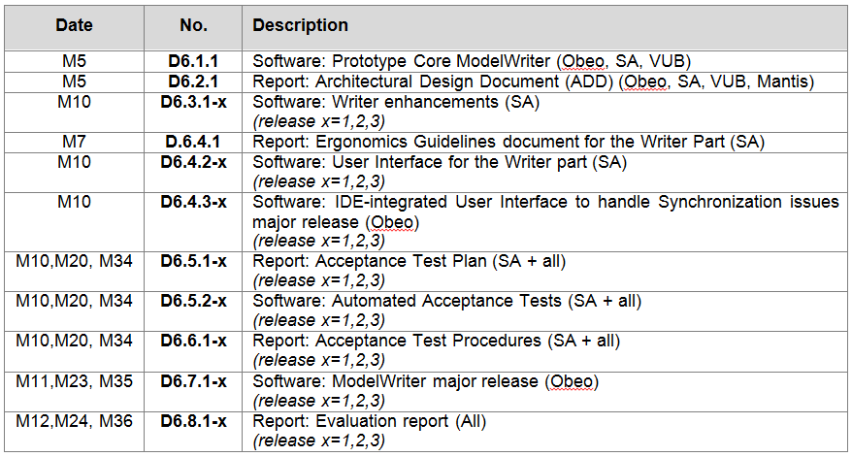
WP6 Deliverables

